Slide 1

U.S. Critical Mineral Import Reliance

Slide 2
Critical Minerals & Their Importance
Critical minerals represent a designation of commodities that are crucial for U.S. economic and manufacturing prosperity
These minerals are typically used for manufacturing of ubiquitous and critical products, such as batteries, semi-conductors, glass, LEDs, and a variety of other devices essential for research and development
Some of these critical minerals include
Bauxite
Palladium
Lithium
Titanium
And other rare earth minerals

Slide 3
U.S. Dependency on Trade for Critical Minerals
The U.S. does not produce all of its own minerals and is thereby dependent on imports from trade partners
However, as we have seen throughout time, political tensions can rise and result in disruptions in trade
Clearly, large-scale disruptions in the trade of critical minerals would greatly impact the U.S. economy by resulting in
The inability to produce essential resources
Reliance on importing manufactured products rather than base minerals
Harm to U.S. manufacturing centers
Thus, it is necessary to critically examine the state of U.S. reliance on imports, the relationships among the U.S. and these various trade partners, and potential alternative sources of mineral acquisition in the event of disruptions

Slide 4
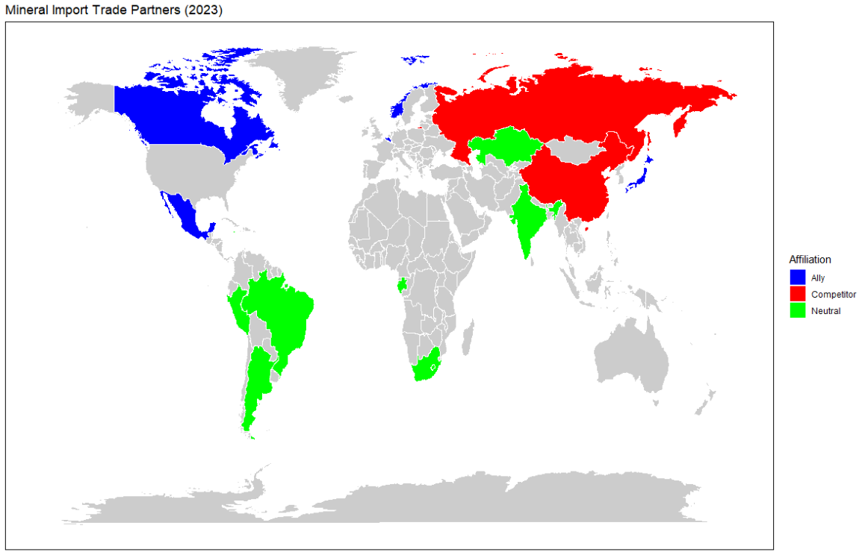
Primary Trade Affiliates for Critical Minerals
The following map shows the most primary sources of critical minerals for the U.S.
As shown, the U.S. tends to trade with allies and neutral parties
However, the U.S. also trades with parties that it has had tensions with in the past and currently
Such as China and Russia
Next, we should examine the state of U.S. dependence on these countries’ mineral imports and the types of minerals they source.

Slide 5
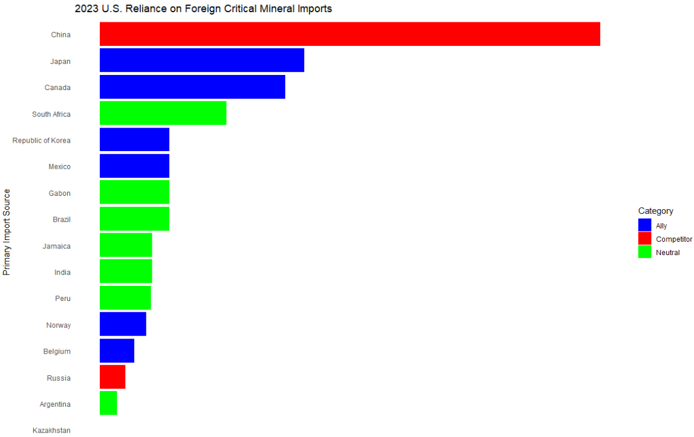
Which Primary Sources is the U.S. Most Reliant Upon?
Based on this graph, the U.S. tends to rely on minerals sourced from allies and countries with neutral/friendly affiliations
However, it is notable that the U.S. is has a high net dependent on minerals imported from China, a notable economic competitor

Slide 6
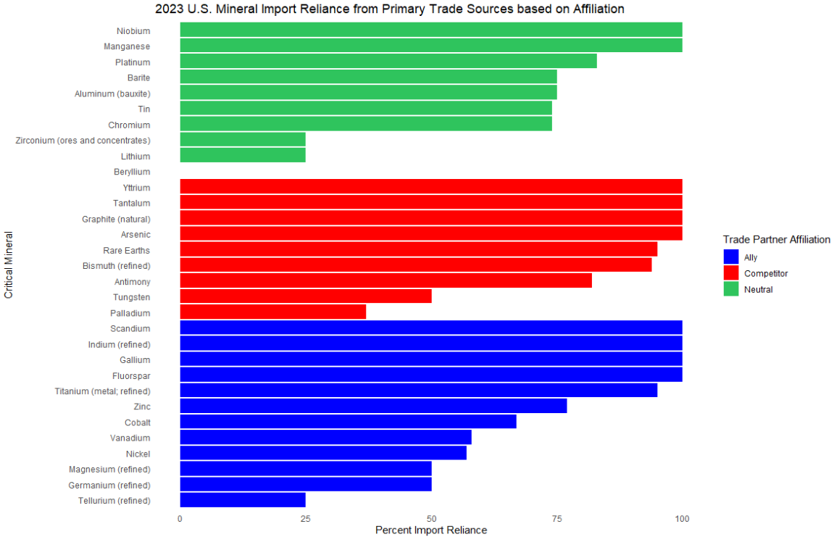
Mineral Import Reliance by Trade Partner Affiliation
This chart shows U.S. import reliance based on mineral consumption, production, and trade
As we can see, while much of U.S. primary importers are countries with more positive relationships, a lot of critical resources are primarily supplied by countries that may have a less favorable relationship with the U.S.
In addition, many of these minerals appear to be very important, based on the import reliance shown

Slide 7
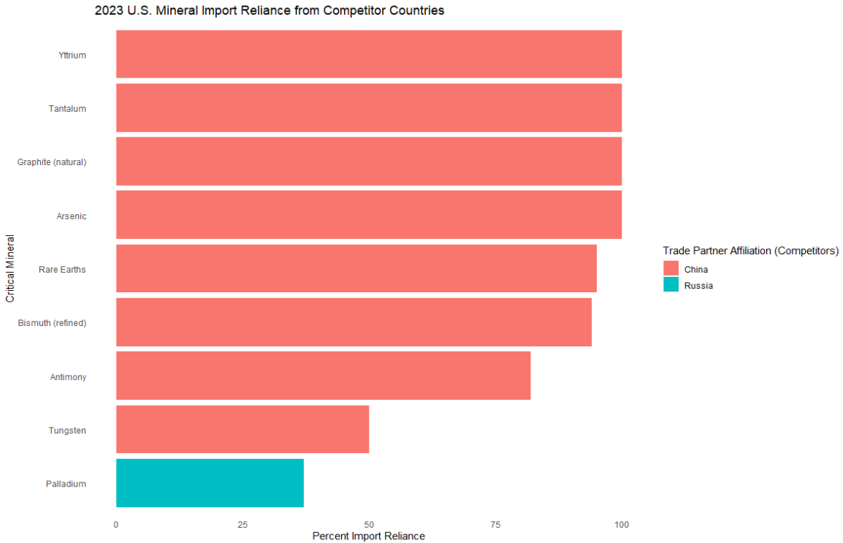
Which Minerals are Traded by Competitor Countries?
The following critical minerals are traded by competitor countries
Clearly, disruption with these countries could lead to difficulties in supplying these key resources
Russia is especially of note, considering the current geopolitical situation
This raises the question of which sources the U.S. can rely on if trade is completely disrupted with these countries
Notes:
To note: Russia still does export certain resources to the U.S. in spite of the Russia-Ukraine war

Slide 8
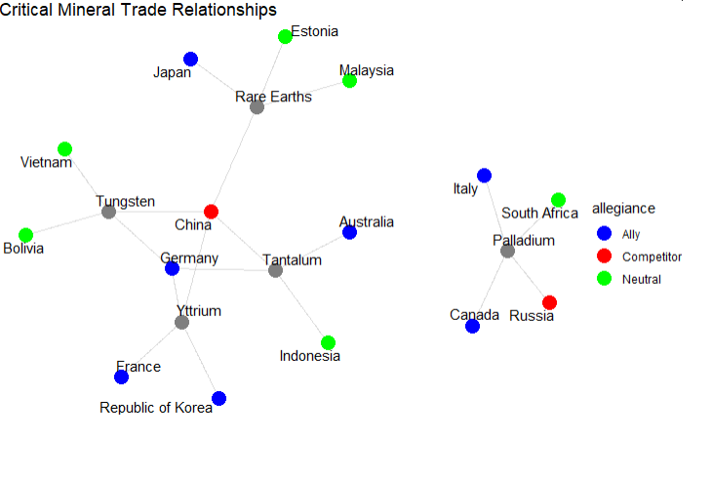
Alternative Sources of Acquisition for These Critical Minerals
Even in the event of disruptions in trade with Russia or China
The U.S. has other reliable sources of trade to acquire these minerals and limit economic disruption

Slide 9
Conclusions
While the U.S. has many trade agreements with allied and neutral countries
There is still a heavy dependence on potential competitors, such as China
Disruption in trade with China could result in economic pitfalls
However, there are alternatives that the U.S. could increase trade with to mitigate losses and facilitate continued manufacturing

